Slide 1
Area Detector
Feb. 2022
Kay Kasemir, Klemen Vodopivec based on presentations by Mark Rivers, APS, U. Chicago

Slide 2
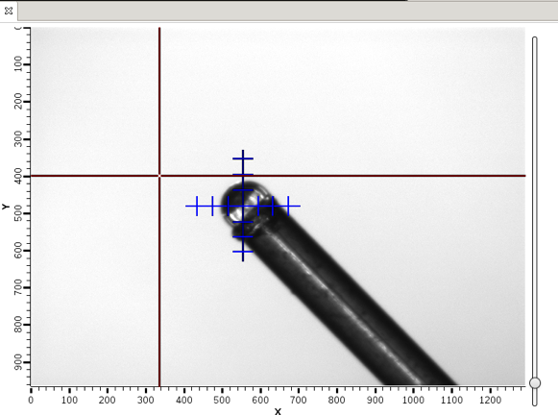
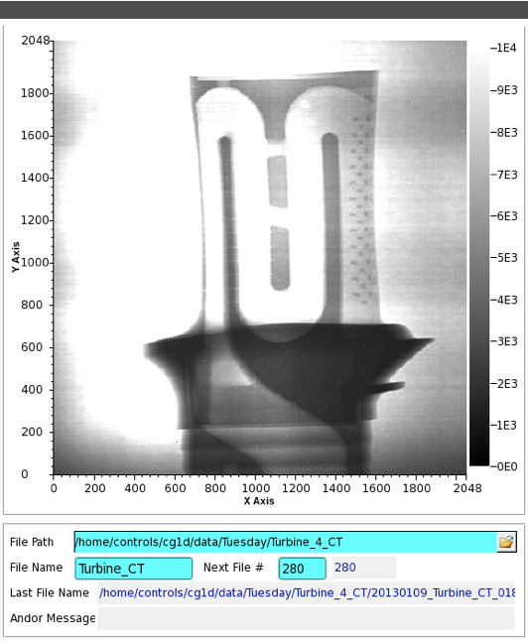
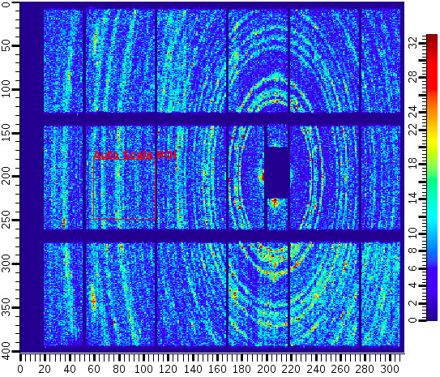
Area Detector
EPICS framework for image manipulation
Cameras
Cheap “Web Cam”
$$$ high speed, high res.
Neutron, X-Ray detectors
Plugins collection
ROI
Transform
ColorConvert
Etc.
Extendibility

Slide 3
Features
Maybe the largest shared EPICS Application
PVs for image settings, shutter, exposure, …
“Simulated” area detector IOC has 6000 records
N-D data
1D: time series data
2D: images (most common)
N<=10
Custom metadata
Supports >500 frame/second detectors

Slide 4
Disclaimer
This will only scratch the surface.
EPICS web site has several days of training material if you are serious about using the A.D.

Slide 5
Vocabulary
Driver
Interface to camera
Vendor libraries, custom protocols
Creates NDArray
Plugin
Manipulates NDArray data
May change data
May send data to other plugins
No-copy if not changed
NDArray
Structure holding data
N-dimensional array
N=2 for basic greyscale image
N>2 for color, detector with “depth”
NDAttribute
Metadata attached to NDArray
Motor position, temperature, shutter,…
Added by driver, from PVs, Plugins…
NDArrayPool
Pool of NDArrays to reduce memory allocation

Slide 6
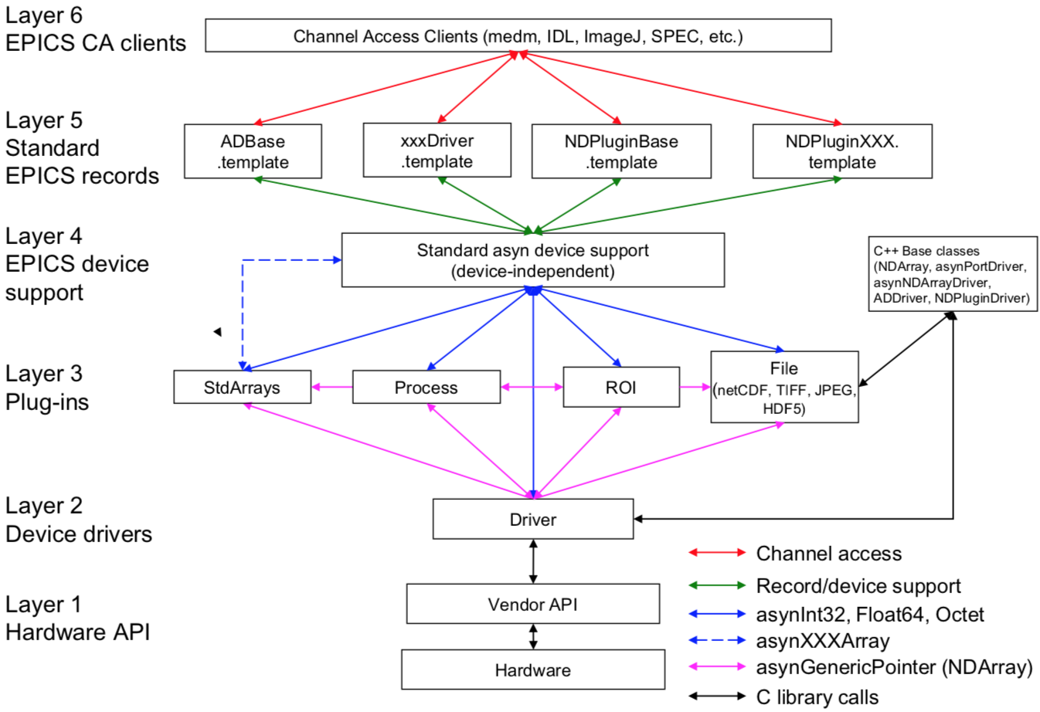
EPICS AreaDetector Architecture

Slide 7
Configurable plugins mechanism
Merges into single channel
Splits series of images into two channels equally
Reads images from camera
FFT
File
Scatter
Gather
Camera Driver
Transform (rot90)
FFT
Stats
CPU intensive operation
Rotates images 90deg clockwise
Stats
Legend:
CPU1
CPU2
CPU3
CPU4
--- original data
--- modified data
Provides PVs like min, max intensity

Slide 8
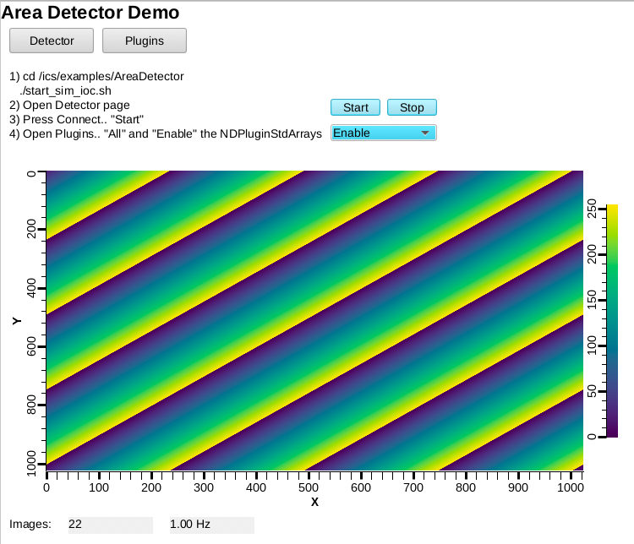
Using ‘ADSimDetector’
Start IOC
cd /ics/examples/AreaDetector ./start_sim_ioc.sh
Open Display
﻿css -resource /ics/examples/AreaDetector/AreaDetectorDemo.bob
Select “Start” and “Enable”

Slide 9
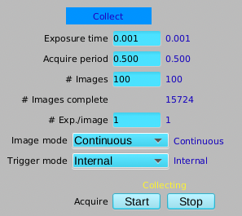
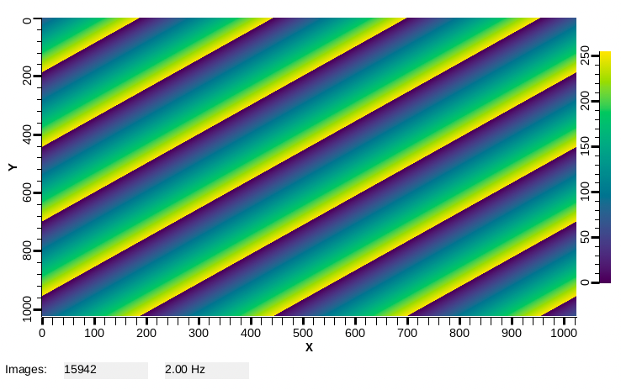
ADSimDetector
Open the “Detector” Page
Under “Collect”, set the “Acquire Period” to 0.5
Observe counter for images and rate on main page

Slide 10
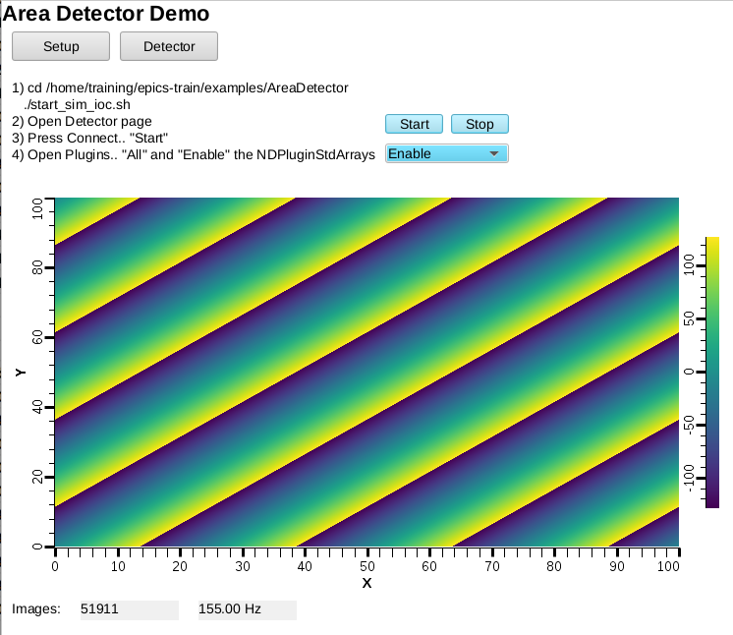
NDPluginStdArrays
Serves image as Channel Access waveform
On Detector, Plugins, All, find NDPluginStdArrays
Port = “SIM1”
Enable
AreaDetectorDemo.bob shows image
PV: 13SIM1:image1:ArrayData
Data Width x Height: 1024 x 1024
[x] Unsigned

Slide 11
NDPluginOverlay
Adds rectangles, text etc. to image
On Detector, Plugins, All, find NDPluginOverlay “OVER1”
Set its Port to “SIM1”, Enable
Change NDPluginStdArrays’s Port to “OVER1”
Press “More”, select first of the “Individual Overlays”

Slide 12
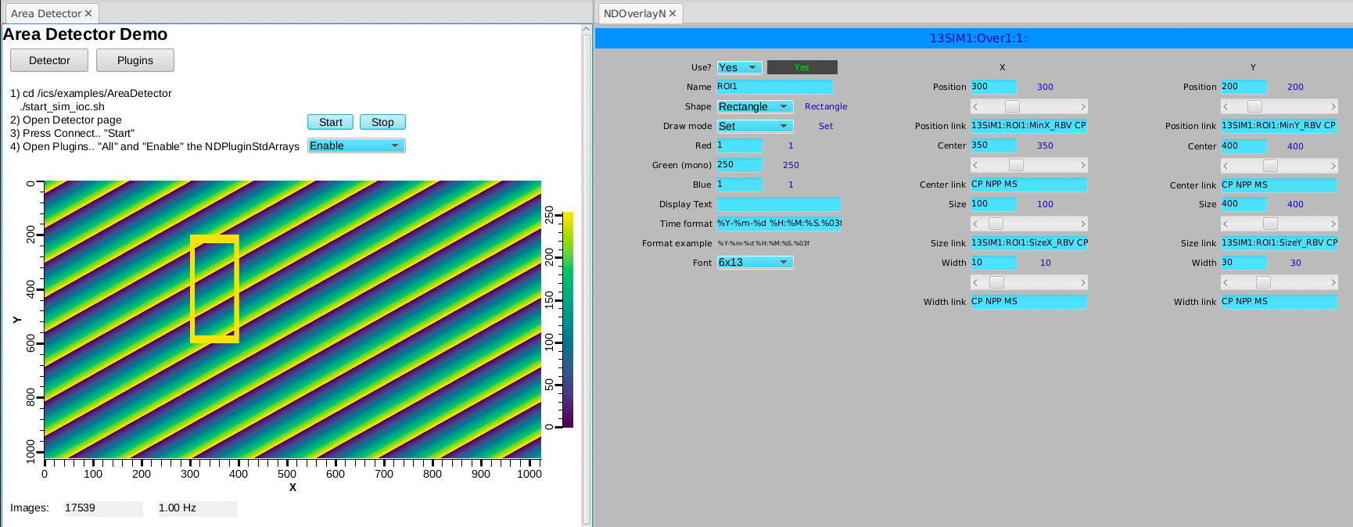
NDPluginOverlay.. Overlay #1
Configure as shown:

Slide 13
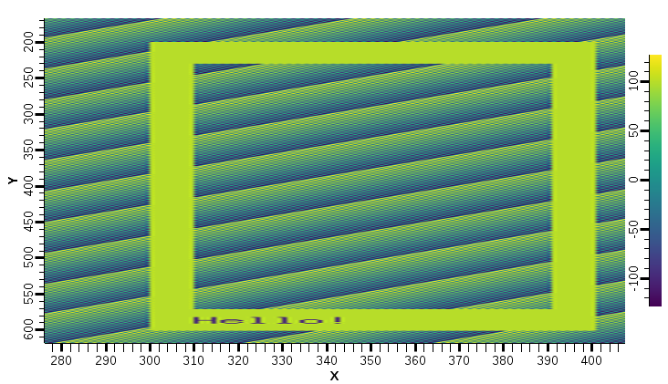
What we did
Area Detector IOC
Image1
Plugins
OVER1
OVER1 offers 8 overlays:
Rectangle
Text “Hello”
…
SIM1
Driver

Slide 14
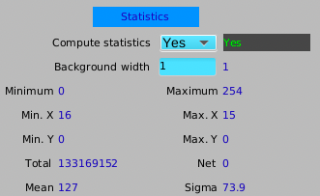
NDPluginStats
Computes min, max intensity etc.
Computes profiles
Advanced image statistics
Excess Kurtosis (flatness)
Skewness (symmetry)
Centroid & sigma
On Detector, Plugins, All, find NDPluginStats “STATS1”, “More”
Set its Port to “SIM1”, Enable
Note how the Statistics show min..max of 0..255

Slide 15
NDPluginROI
Performs Region-Of-Interest calculations
Selects part of image
On Detector, Plugins, All, find NDPluginROI “ROI1”, “More”
Set its Port to “SIM1”, Enable
Set X and Y ROI size to 10, so ROI is small 10x10 corner of image
Back in STAT1, change port from “SIM1” to “ROI1”
Note how the Statistics show a varying min..max as the image data rolls through that ROI

Slide 16
What we did
Area Detector IOC
Image1
STATS1
Plugins
OVER1
ROI1
SIM1
Driver

Slide 17
More Plugins
Process
Background subtraction, clipping, recursive averaging over N images, ..
Saving images in various formats
Adding data from PVs as “Attributes”
PNG, JPEG, TIFF, HDF5, …
Serving NDArray via PVA
For displays: No need to configure size, data type, …
For ADPvAccess Driver: Process data on different hosts

Slide 18
NDPluginPVA – Serve PVA ‘Image’
In Plugins, “PVA1”
Set its Port to “SIM1” or “OVER1”, Enable
PVAccess Tests
pvlist
pvinfo 13SIM1:Pva1:Image
pvget -r 'field(dimension)' 13SIM1:Pva1:Image
In Display
Use “Image” widget
Set PV
No need to configure data size, data type

Slide 19
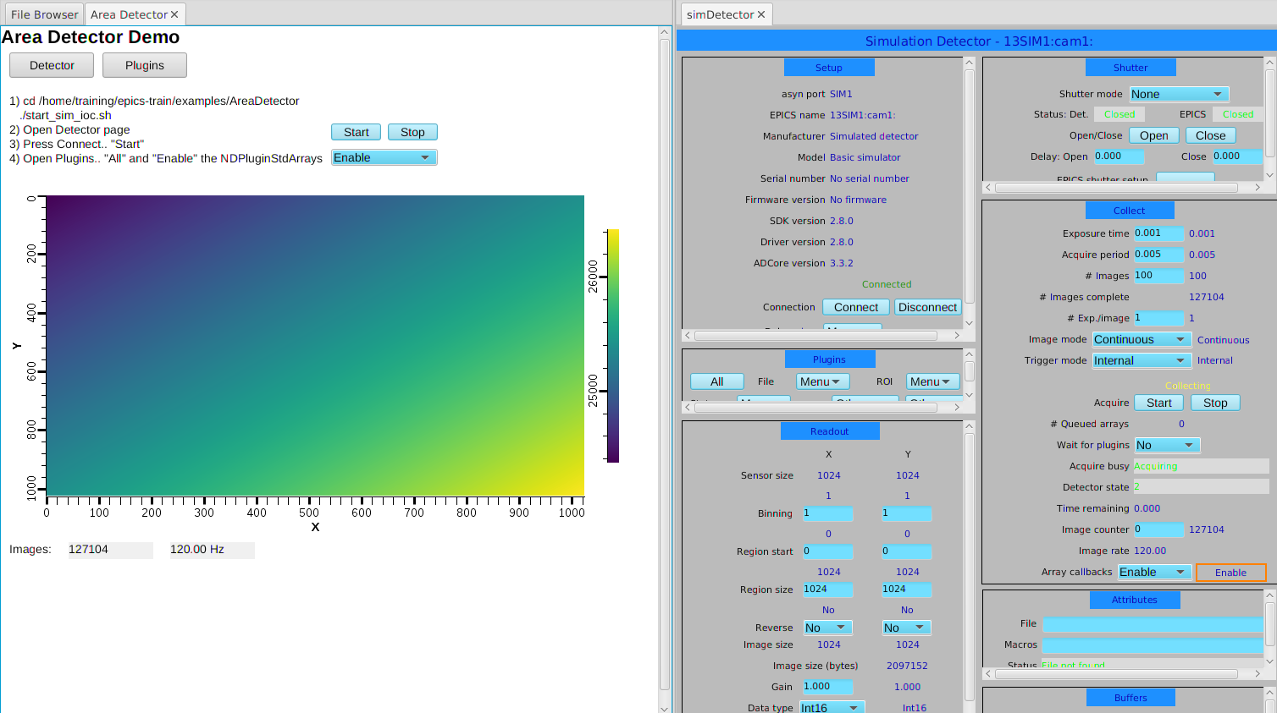
NDPluginPVA – Serve PVA ‘Image’
Display adapts when image size and data type change

Slide 20
Area Detector
Ecosystem for handling
Cameras
Detectors
“Images” in EPICS

